Slide 1
College Fit
By: Alex So

Slide 2

How do you save money on college?
- Scholarships, Grants, Loans
- Possibly a part time job
College

Slide 3



Start at the beginning
Choosing your college

Slide 4
Statistics
2015 report by the National Student Clearinghouse Research Center found that 36.6% of college students transfer and that nearly half of those do it more than once
According to the U.S. Department of Education, 6-year graduation rate in fall 2009 was 59%. Meaning that of the students that entered college in 2009, 59% of them graduated in 2015.
Nearly 40 percent of transfer student get no credit for any of the courses they have completed and lose 27 credits on average — or about a year of school, according to a 2014 federal study.

Slide 5
Major Reasons:
Financial Costs
The “Fit” of the school
Academic Reasons

Slide 6



Solution:
Match Students with an ideal school the first time around

Slide 7

Process:
Step 1: Data Collection

Slide 8


Process:
Step 2: Data Analysis

Slide 9
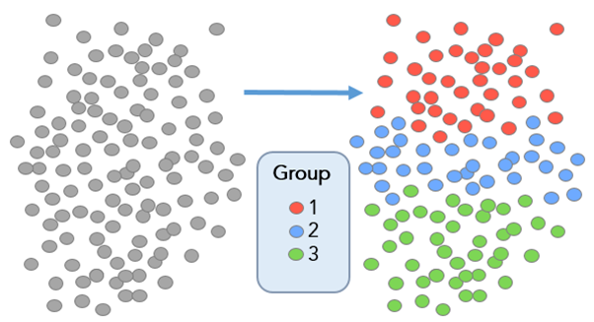
Process:
Step 3: Categorize and Group Data

Slide 10

Process:
Step 4: Collect User Data & Profile Matching

Slide 11
Process:
Further development could involve factoring scholarships, grants, and loans based on the user provided information

Slide 12
Works Cited
https://nces.ed.gov/fastfacts/display.asp?id=40
https://www.washingtonpost.com/news/answer-sheet/wp/2017/01/29/why-so-many-college-students-decide-to-transfer/?noredirect=on&utm_term=.b56522ba933b

